Slide 1



Enterprise Container Management mit OpenShift
Tobias Derksen

Slide 2

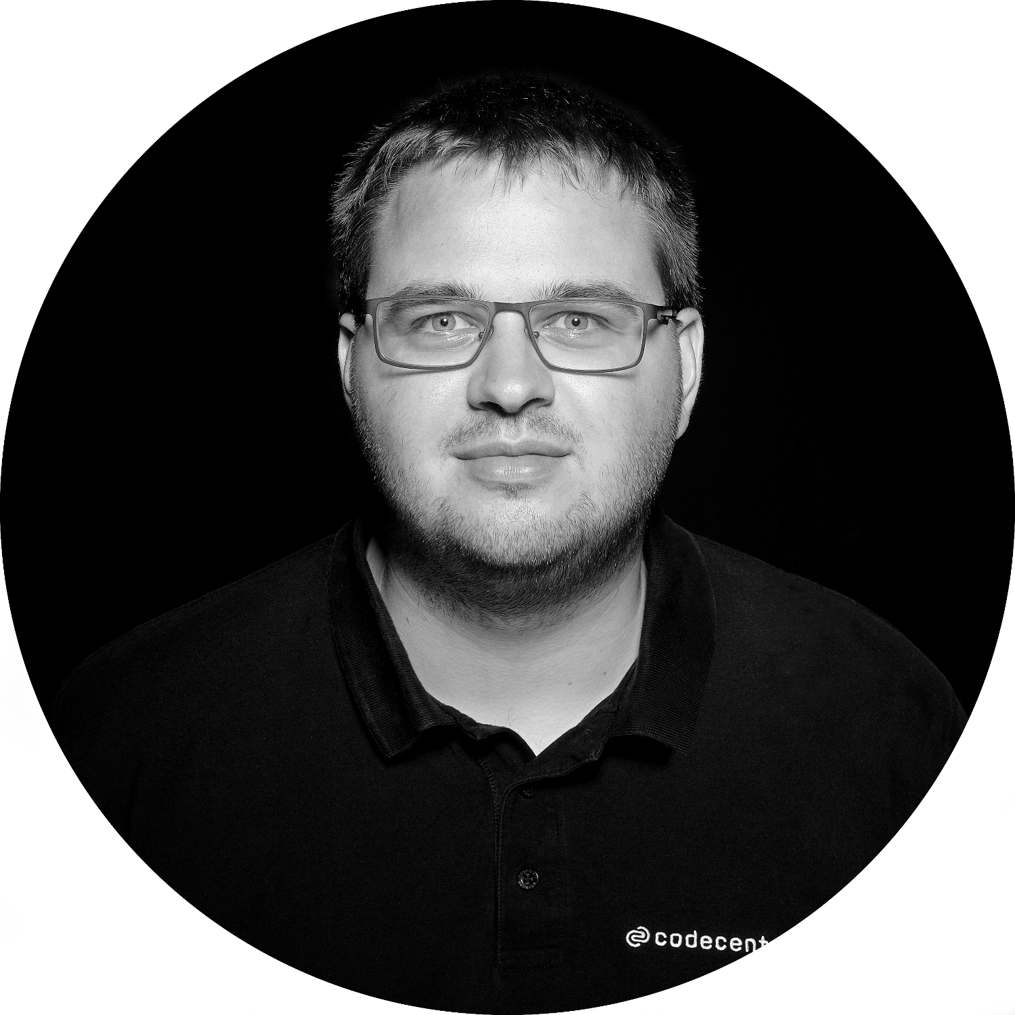
Über mich …
Tobias Derksen
IT Consultant @codecentric
DevOps Specialist
OpenShift Trainer
RedHat Certified Engineer
Notes:
https://docs.okd.io/3.11/install/prerequisites.html#required-ports

Slide 3
Übersicht Container
4

Slide 4
Show inner communication (database)
Automated processes
(connect to github)
Show pipeline
Build Applications
Deploy Applications
(show example)
Notes:
https://docs.okd.io/3.11/install/prerequisites.html#required-ports

Slide 5
Virtuelle Maschinen
Container
VM
Container
Container
Container
Container
App
App
App
App
App
App
App
App
OS Dependencies
OS deps
OS deps
OS deps
OS deps
Kernel
Container Host (Kernel)
Hypervisor
Hardware
Hardware
Virtuelle Maschine sind isoliert
Applikationen sind nicht isoliert
Container sind isoliert
Applikationen auch
Notes:
https://docs.okd.io/3.11/install/prerequisites.html#required-ports

Slide 6
Virtual Machine
Container
Application
Application
OS dependencies
OS dependencies
Operating System
Container Host
VM Isolation
Complete OS
Static Compute
Static Memory
High Resource Usage
Container Isolation
Shared Kernel
Burstable Compute
Burstable Memory
Low Resource Usage
Notes:
https://docs.okd.io/3.11/install/prerequisites.html#required-ports

Slide 7





Container
Container
Container
Container
Container
Application
Application
Application
Application
Application
OS dependencies
OS dependencies
OS dependencies
OS dependencies
OS dependencies
RHEL
RHEL
RHEL
RHEL
RHEL
Guest VM
Virtual Machine
Virtual Machine
Virtual Machine
LAPTOP
BARE METAL
VIRTUALIZATION
PRIVATE CLOUD
PUBLIC CLOUD
Notes:
https://docs.okd.io/3.11/install/prerequisites.html#required-ports

Slide 8
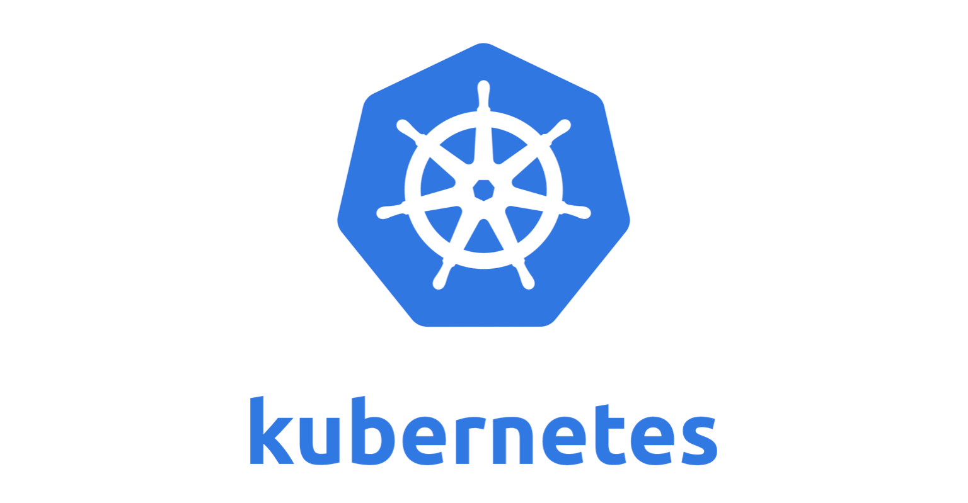
Notes:
https://docs.okd.io/3.11/install/prerequisites.html#required-ports

Slide 9



Was ein Chaos ...
Notes:
https://docs.okd.io/3.11/install/prerequisites.html#required-ports

Slide 10
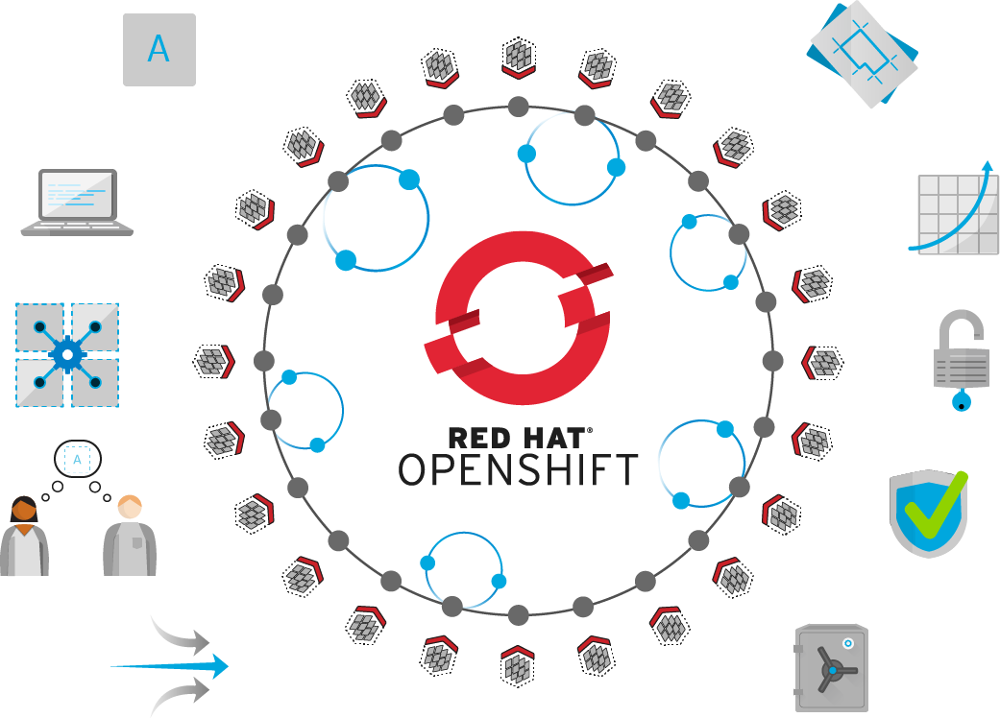
Self-Service
Standards-based
Multi-language
Web-scale
Automation
Open Source
Collaboration
Enterprise Grade
Multi-tenant
Secure
Notes:
https://docs.okd.io/3.11/install/prerequisites.html#required-ports

Slide 11
OpenShift ist … kubernetes plus
Routing
Metriken
Logging
Web Oberfläche
Builds
Image Registry
Sicherheitsmaßnahmen
SDN
Templates
Mit Redhat Subscription:
Trusted Registry
Security Newsletter
Support
Notes:
https://docs.okd.io/3.11/install/prerequisites.html#required-ports

Slide 12














ROUTING LAYER
SERVICE LAYER
RED HAT
ENTERPRISE LINUX
NODE
NODE
NODE
PERSISTENT
STORAGE
SCM
(GIT)
MASTER
C
C
API/AUTHENTICATION
c
CI/CD
C
C
C
DATA STORE
RHEL
RHEL
RHEL
SCHEDULER
NODE
NODE
NODE
REGISTRY
EXISTING AUTOMATION TOOLSETS
HEALTH/SCALING
C
C
C
C
C
RHEL
RHEL
RHEL
PHYSICAL
VIRTUAL
PRIVATE
PUBLIC
HYBRID
Notes:
https://docs.okd.io/3.11/install/prerequisites.html#required-ports

Slide 13
Notes:
https://docs.okd.io/3.11/install/prerequisites.html#required-ports

Slide 14
Notes:
https://docs.okd.io/3.11/install/prerequisites.html#required-ports

Slide 15
Begriffe
Container
Pod
Node
Projekt
Namespace
etcd
Gluster
Ansible
Inventory
Playbook
Notes:
https://docs.okd.io/3.11/scaling_performance/cluster_limits.html

Slide 16
Cluster Konzeption

Slide 17
Verschiedene Node Typen
Master Nodes
API - Server
ETCD
Web Console
Infrastructure Nodes
Router
Image Registry
Logging Stack
Metriken
Storage Controller
Compute Nodes
Applikationen
Services
Datenbanken
Builds
Andere Workloads
Storage Nodes
Nur beim EInsatz von Gluster
Nodes mit physischem Speicher

Slide 18
OpenShift Identity Provider
Möglichkeiten zur User Verwaltung
HTPASSWD
Hard-coded Passwörter im htpasswd Format welche lokal auf den Mastern liegen.
LDAP
Generischer LDAP Authenticator. Kann mit jedem handelsüblichen LDAP Server verbunden werden.
Social Logins
Github
Gitlab
Google
OpenID Connect
Generischer OpenID Connect Authenticator. Kann jeden OAuth2 oder OIDC Provider anbinden.
Notes:
https://docs.okd.io/3.11/install_config/configuring_authentication.html

Slide 19
Skalierung & HA
Notes:
https://docs.okd.io/3.11/scaling_performance/index.html

Slide 20
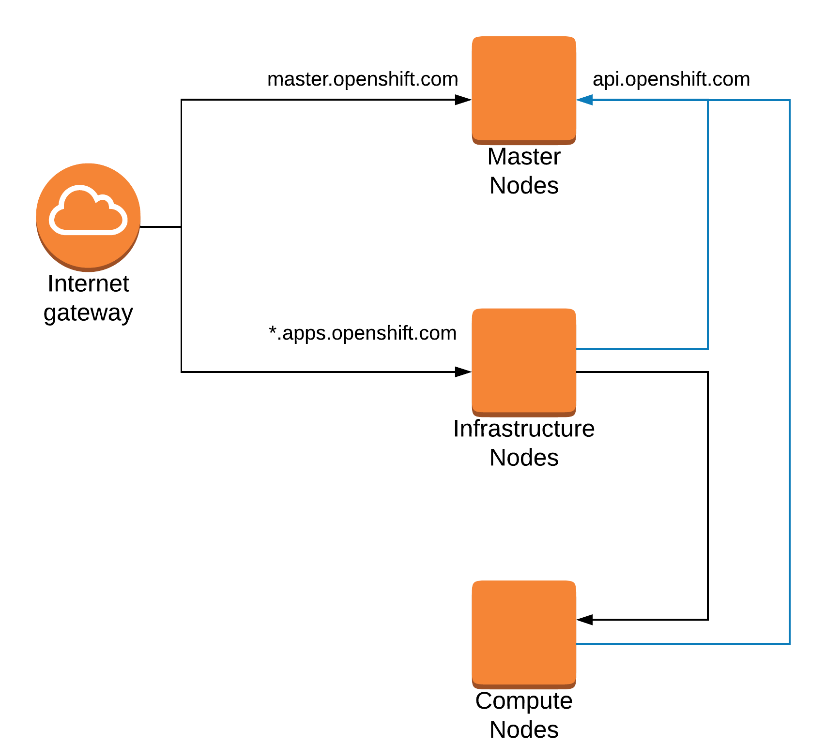

Slide 21
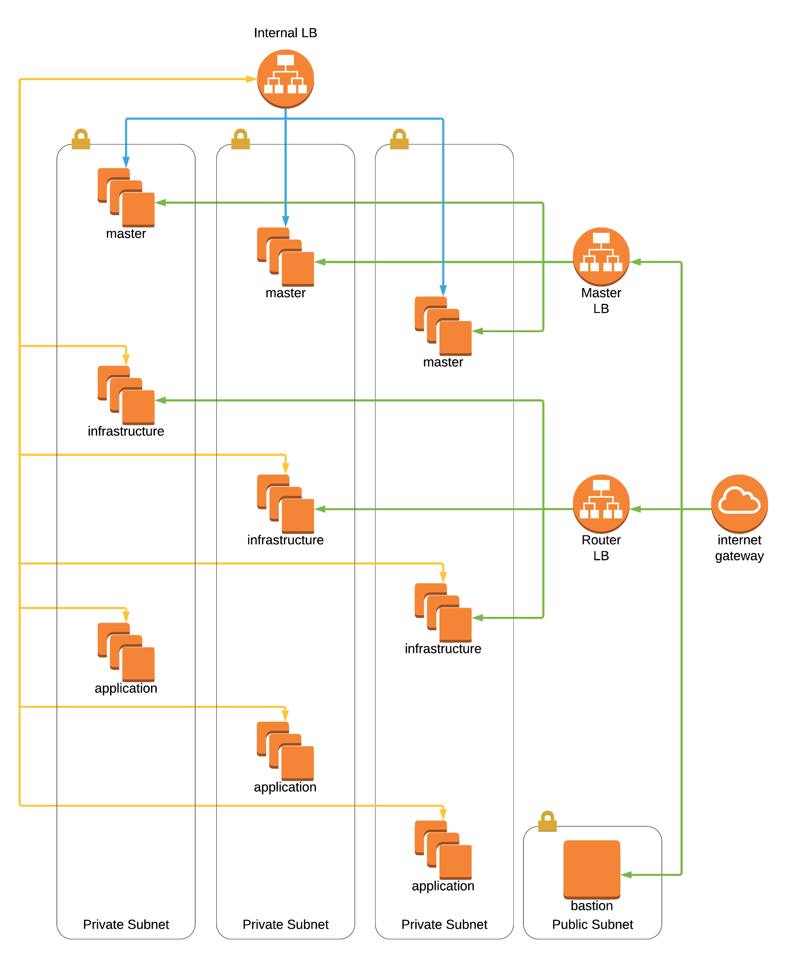

Slide 22
Persistent Storage

Slide 23







“Bound to”
“sets up”
“submits”
“submitted to”
“creates”
“mounted by”
PersistentVolumeClaim
StorageClass
PersistentVolume
“A request for storage”
Provider: ABC
Capacity: 10 GiB
Features: XYZ
“A provider of storage”
Provider URL: …
Credentials: …
Options: ...
“Provisioned Storage”
Name: …
Size: …
AccessMode: ...
“instructs”
“provisions”
Storage Backend
Notes:
https://docs.okd.io/3.11/install/prerequisites.html#required-ports

Slide 24
Persistent Storage Provider
HostPath
EmptyDir (Ephemeral Storage)
GlusterFS / OpenShift Container Storage
NFS (unsupported)
iSCSI
Ceph
Diverse Cloud Mechanismen (AWS, GCE, Azure, etc)
Dynamic Provisioning
Notes:
https://docs.okd.io/3.11/install_config/persistent_storage/index.html

Slide 25

Stay connected
Slides & Beispiele
https://github.com/lukeelten/openshift-slac
Adresse
codecentric AG
Köpenicker Straße 31
10179 Berlin - Mitte
Contact Info
E-Mail: tobias.derksen@codecentric.de
GitHub: https://github.com/lukeelten
www.codecentric.de
Telephone
Telefon: +49 (0) 170 2295 733

